Slide 1
Car Launch Analysis
For UNITED KINGDOM
Presented by Deepak Sonawane

Slide 2
Car Launch Analysis
Car Analysis
The purpose of Causal Analysis is to identify causes of selected outcomes .
Car Resolution
A Car resolution is a take action to improve process performance.

Slide 3
Sale on class of Customer Class
We have data from 1997 to 2020 of cars like BMW, Mercedes , Hyundai , Audi and Cclass .
On the basis of the dataset we observe some conclusion. Eg I took a Audi dataset on the basis of that I calculate observe some insights.
The class is determine on the basis of the car sold out in there economy the customer buy easily.
We divide customers on the basis of there economy class,
A) Rich
B) poor
Rich class are buy most car brand they are reputedly change the car. In the chart as compare Audi a8 and Audi Q2 the Q2 car is most better and luxurious and it has best average and milage.

Slide 4
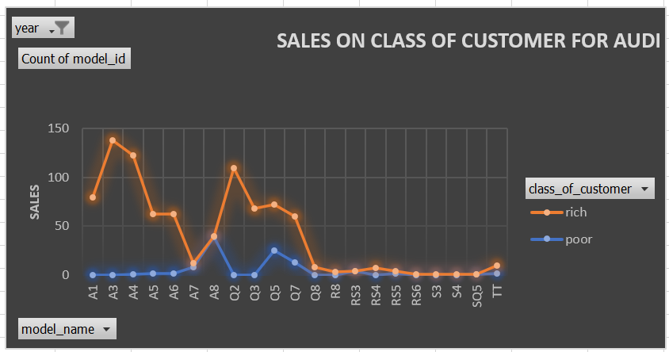
Sales on Class of Customer

Slide 5
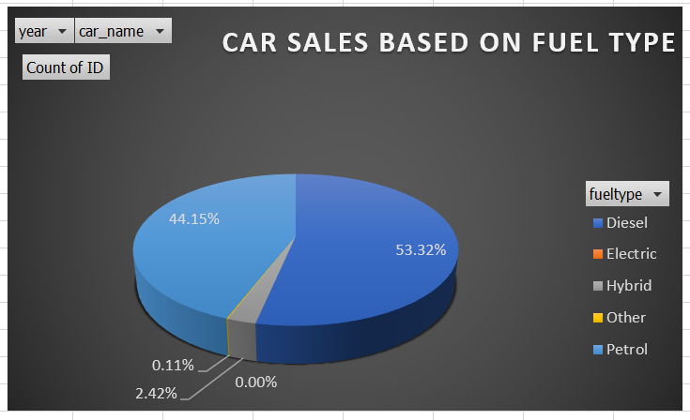
Car Sales based on Fuel Type
In United Kingdom, most of the cars brand Audi, BMW, Hyundai, Mercedes and Cclass are depends on the Diesel which has 53.32%.
44.15% cars are depends on the Petrol.
0.11% cars are depend on the electric.
And 2.42% cars are depend on the hybrid means CNG etc
Notes:
hkjof

Slide 6
Car sales Decreases

Slide 7
Car sales Decreases
In the covid pandemic the total sales of automobile has been decreases because of the lockdown.
We can see the huge lag between 2019 and 2020.
In the pandemic lockdown the car was’nt sold it may have financial crisis and the shut down of shop.

Slide 8
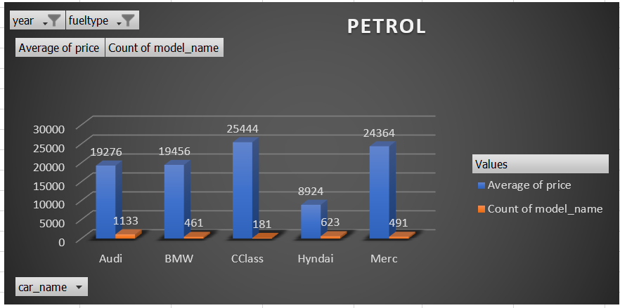
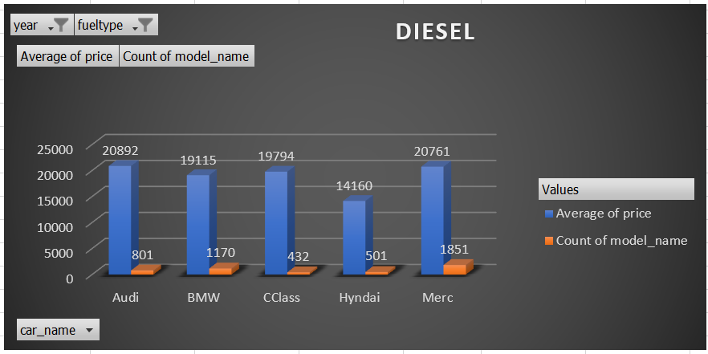
Fuel efficiency Diesel Vs Petrol

Slide 9
Fuel efficiency
fuel efficiency is defined as a measure of how much a car will convert energy in fuel into kinetic energy to travel.
Diesel engine are more efficient then petrol ones because of the high energy content diesel fuel
While petrol cars are closing the gap for efficiency
Diesel engine is much stronger than petrol engine

Slide 10
https://1drv.ms/u/s!AjKEiirU64cehFgsa--vXW4HFuFo?e=f9u7GS
Project queries

Slide 11
d
Thank You…

